Slide 1
Chess App
A Real-time Multiplayer Chess Game with Move Evaluation
Presented By: Ajay Soni Verma
Enrollment No. 2022btcse006
Btech. CSE VI Semester
Subject: Software Engineering Lab

Slide 2
Introduction
This project delivers a comprehensive mobile chess application designed to enhance the classic game experience. It combines traditional gameplay with modern features like real-time multiplayer, AI opponents, and detailed PGN-based game analysis for move evaluation. The CHESS APP aims to provide both an enjoyable platform for casual players and a powerful learning tool with feedback on gameplay decisions to help players improve their skills.

Slide 3
01
Features

Slide 4
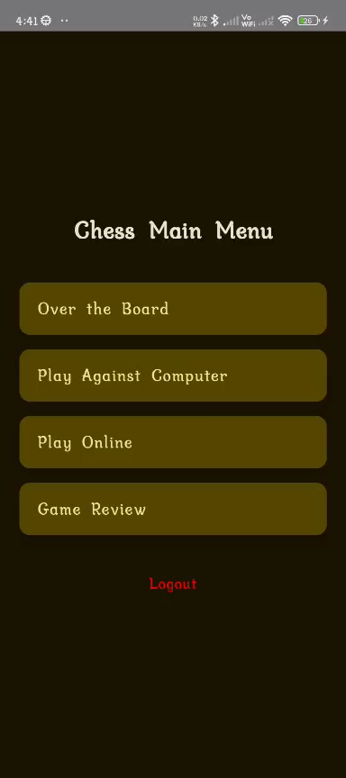
Over-the-Board mode specifics
The Over-the-Board mode allows two players to engage in a local, face-to-face chess game. Players can use the app to set up the board and make moves, which are recorded in real-time. The board orientation can be flipped to accommodate players’ preferences, enhancing usability and convenience.

Slide 5
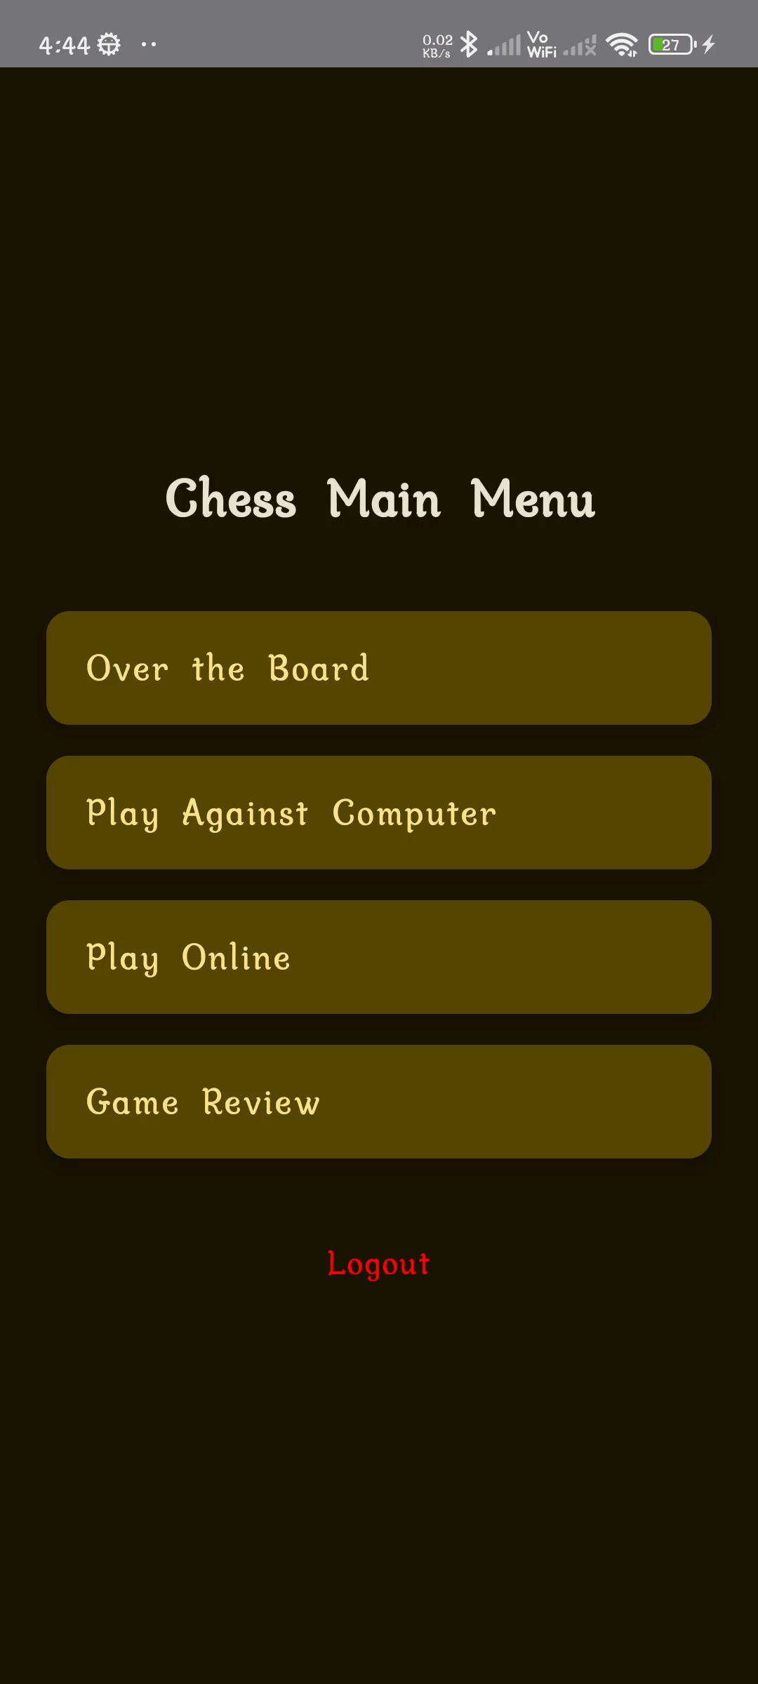
Online Multiplayer features
Online Multiplayer mode is designed for real-time, competitive play with a 10-minute timer for each player. This mode ensures that games maintain a brisk pace, highlighting the strategic aspects of chess under time constraints. Players can challenge friends or match against anonymous opponents, fostering a dynamic online community.

Slide 6
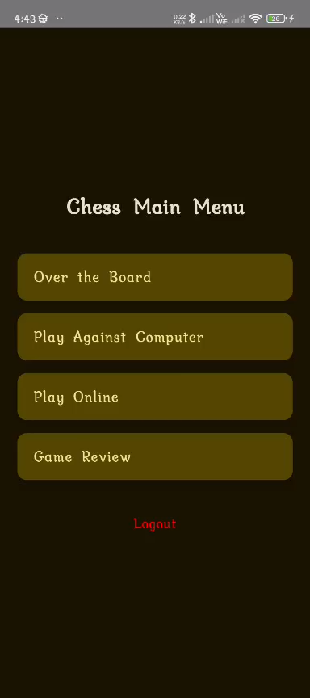
AI Opponent functionality
The AI Opponent feature allows players to practice their skills against a computer-generated opponent. This functionality can adapt to varying difficulty levels, providing a tailored experience for users from novice to advanced. The AI utilizes sophisticated algorithms to make strategic moves, simulating a real chess play environment and helping users improve through practice.

Slide 7
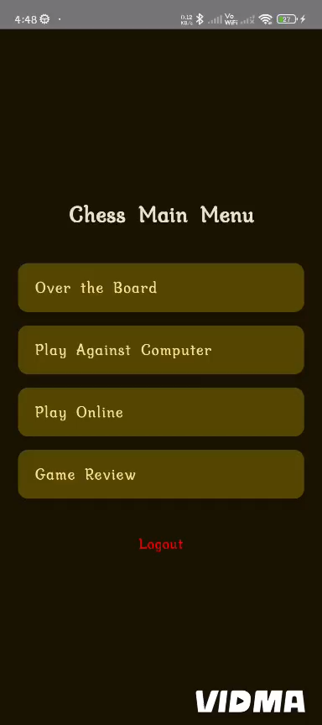
Game Analysis
The Game Review feature enables players to analyze completed matches in detail, offering insights into move accuracy, strategy, and overall gameplay quality. This functionality highlights critical moments, categorizes mistakes and blunders, and suggests optimal alternatives using stockfish evaluation. By retracing their moves with interactive commentary and visual cues, players can better understand their decision-making process and identify areas for improvement. Whether used for casual reflection or serious training, Game Review provides a structured learning experience that enhances chess skills over time.

Slide 8
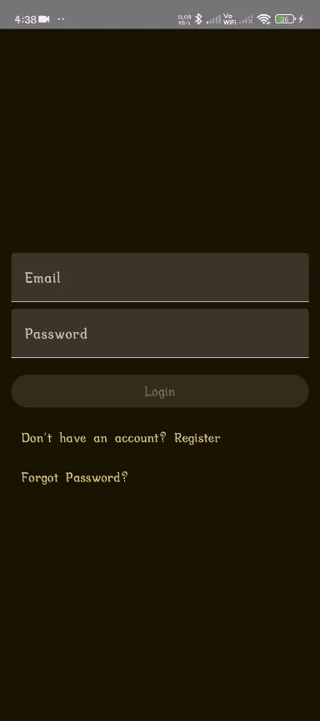
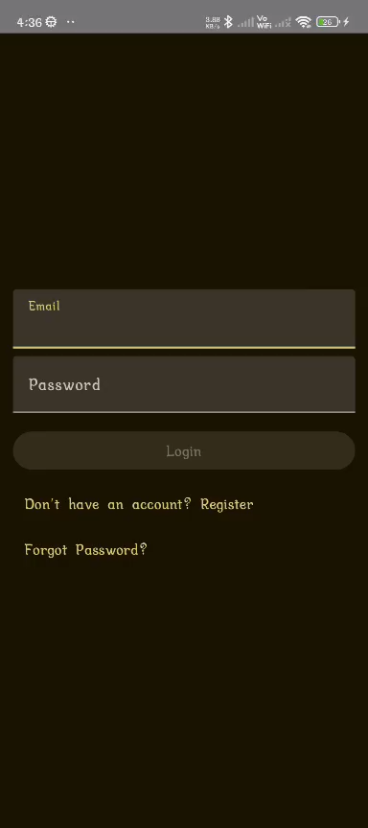
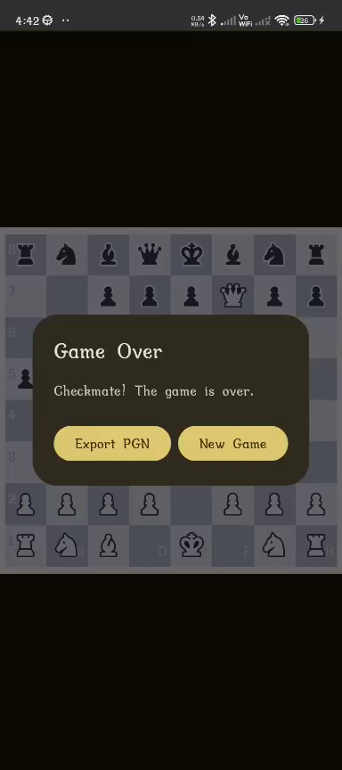
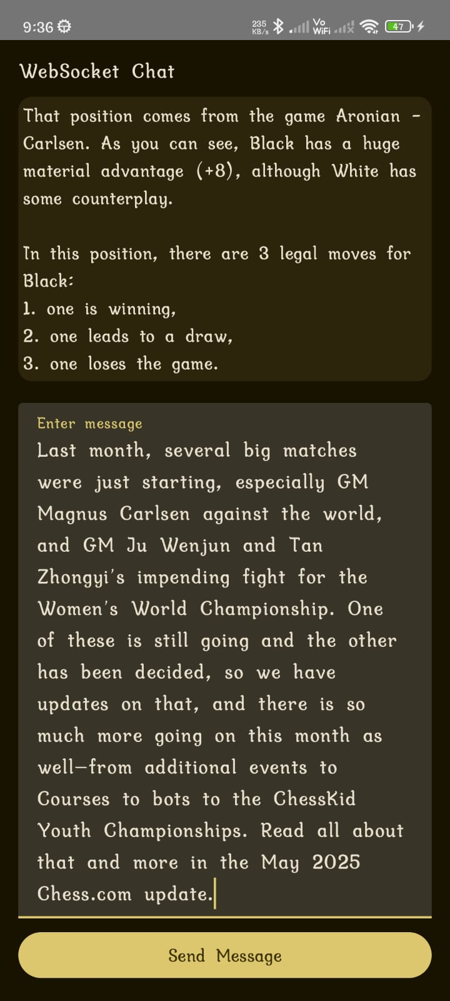
Other Features:
Login
Registration
Export PGN
Community

Slide 9
02
Development Process

Slide 10
Project timeline overview
The development process is structured over a six-week timeline, starting with project setup and local multiplayer implementation. The timeline includes the integration of the AI opponent, establishment of user authentication systems, and subsequent implementation of online multiplayer features. Each week is dedicated to specific functionalities, ensuring steady progress and systematic development.

Slide 11
Implementation challenges faced
Throughout the development process, several challenges were encountered, including the integration of WebSockets for real-time multiplayer functionality. Additionally, effective implementation of the Stockfish engine for game analysis required careful consideration due to its complexity. These challenges necessitated iterative testing and debugging to ensure a seamless experience for users.

Slide 12
Testing and quality assurance strategies
A comprehensive testing strategy was implemented to ensure the application functions correctly across all features. This includes rigorous authentication testing, gameplay validation, and synchronization checks for multiplayer modes. Aso focused on validating the accuracy of game analysis functionalities, ensuring that the feedback provided is reliable and beneficial for user development.

Slide 13
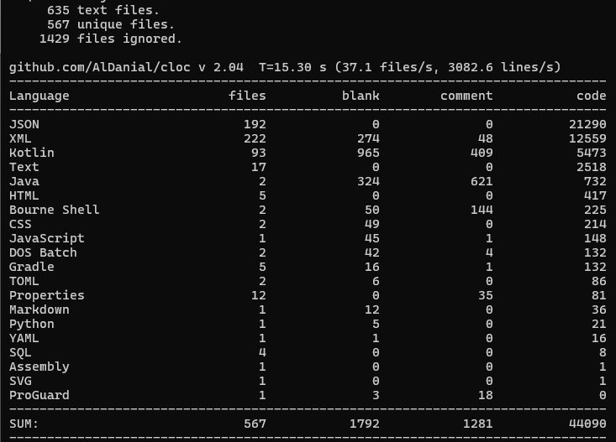
Codebase Summary

Slide 14
Thank You
Any Questions?

